Slide 1

“I want to compare travel options quickly and book the best one without getting confused.”
Goals
Search for the cheapest and fastest way to travel.
Compare flights and trains conveniently.
Search for seat availability, timings and fare details.
Frustrations
Too many filters and crowded interfaces.
Hidden charges shown only at checkout.
Pages load slow in peak times.
Unable to compare various modes of travel.
Aditi Sharma
Age: 21
Education: B.Tech Computer Engg.
Hometown: Pune, Maharashtra
Family: Lives with parents and younger brother
Occupation: Student
Aditi is a college student who frequently travels between Pune and Delhi during vacations and holidays. She spends time comparing dates and discounts, but gets frustrated when fares increase before checkout.

Slide 2
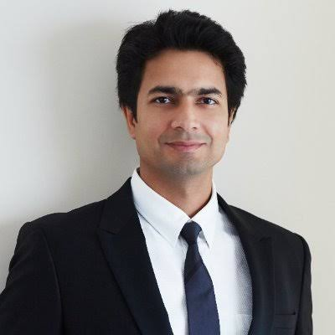
“My booking process should be quick because every minute matters.”
Goals
Fast booking
Flexible cancellations
Easy expense tracking
Frustrations
Long checkout process
Delayed refunds
Complicated cancellation policies
Poor customer support
Rahul Mehta
Name: Rahul Mehta
Age: 34
Education: MBA
Hometown: Mumbai, Maharashtra
Family: Married with one child
Occupation: Sales Manager
Rahul often books flights just hours before meetings. He needs the fastest booking flow possible and values flexible cancellations more than the cheapest fare.

Slide 3

“I want trustworthy travel information before booking.”
Goals
Compare airlines.
Book flights and hotels together.
View prices clearly.
Receive travel updates.
Frustrations
Currency confusion.
Hidden fees.
Limited local travel information.
Complicated refund policies.
Emily Carter
Name: Emily Carter
Age: 28
Education: Master's Degree
Hometown: London, UK
Family: Lives alone
Occupation: Graphic Designer
Emily is visiting India for the first time. She uses MakeMyTrip to book flights and hotels while traveling in India. She wants reliable travel information, transparent pricing and a smooth booking experience.

Slide 4
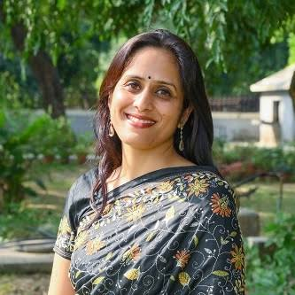
“I need one platform where I can book everything for my family”
Goals
Book multiple tickets together.
Find affordable family packages.
Choose preferred seats.
Get reliable travel information.
Frustrations
Complex booking forms.
Limited family-friendly filters.
Confusing baggage information.
Neha Verma
Name: Neha Verma
Age: 40
Education: Graduate
Hometown: Delhi
Family: Husband and two children
Occupation: Homemaker
Neha books flights, hotels, and airport transfers together for her family vacations. She looks for transparent pricing and family-friendly options without having to navigate multiple pages.

Slide 5

“I prefer simple websites that are easy to understand.”
Goals
Read information clearly.
Receive booking updates.
Get assistance if required.
Frustrations
Small fonts.
Too many advertisements.
Complex navigation.
Difficult payment process.
Ramesh Iyer
Name: Ramesh Iyer
Age: 63
Education: Retired Engineer
Hometown: Chennai, Tamil Nadu
Family: Lives with wife
Occupation: Retired
Ramesh uses MakeMyTrip to book flights when visiting his children in different cities. He values a simple, clutter-free interface with clear instructions, but finds small text and too many on-screen options overwhelming.

